Slide 1

Introduction to Spring boot
Presented By Rinku Sharma

Slide 2
Spring Boot Topics
What is Spring Boot ?
What is NOT Spring Boot?
Why Spring Boot?
Advantages of Spring Boot
Main Goal of Spring Boot
Key Components of Spring Boot Framework
Limitation/Drawback of Spring Boot
Example of Rest Web Service calling using Spring
Example of Rest Web Service calling using Spring Boot

Slide 3
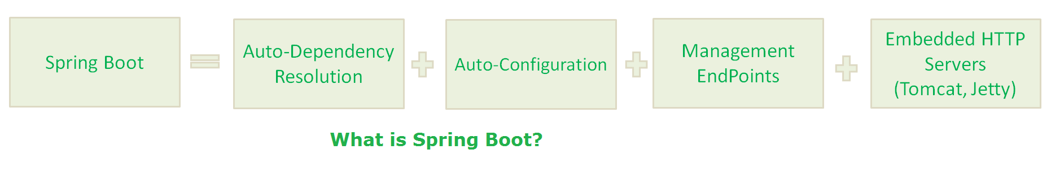
What is Spring Boot ?
Spring Boot is a Framework from “The Spring Team” to ease the bootstrapping and development of new Spring Applications.
It provides defaults for code and annotation configuration to quick start new Spring projects within no time.
Spring Boot Framework is Auto-Dependency Resolution, Auto-Configuration, Management EndPoints, Embedded HTTP Servers(Jetty/Tomcat etc.)

Slide 4
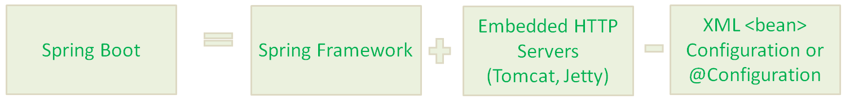
In Simple Terminology, What Spring Boot means
That means Spring Boot is nothing but existing Spring Framework + Some Embedded HTTP Servers (Tomcat/Jetty etc.) – XML or Annotations Configurations. Here minus means we don’t need to write any XML Configuration and few Annotations only.

Slide 5
What is NOT Spring Boot?
Spring Boot Framework is not implemented from the scratch by The Spring Team, rather than implemented on top of existing Spring Framework.
It is not used for solving any new problems. It is used to solve same problems like Spring Framework.

Slide 6
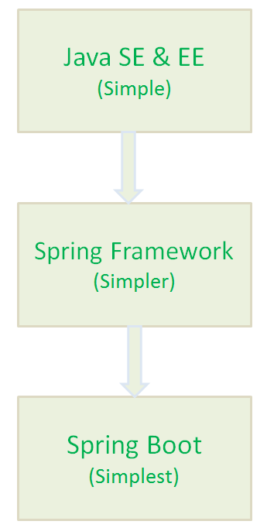
Why Spring Boot ?
Create stand-alone Spring applications
Embed Tomcat, Jetty or Undertow
directly (no need to deploy WAR files)
Absolutely no code generation and no
requirement for XML configuration
To ease the Java-based applications Development
To reduce Development time by providing some defaults.
To increase Productivity.
Spring Boot Framework aims to simplify Spring Development.

Slide 7
Advantages of Spring Boot
It is very easy to develop Spring Based applications with Java or Groovy.
It reduces lots of development time and increases productivity.
It is very easy to integrate Spring Boot Application with its Spring Ecosystem like Spring JDBC, Spring ORM, Spring Data, Spring Security etc.

Slide 8
Main Goal of Spring Boot:
The main goal of Spring Boot Framework is to reduce Development
To avoid XML Configuration completely
To avoid defining more Annotation Configuration(It combined some existing Spring Framework Annotations to a simple and single Annotation)
To avoid writing lots of import statements
To provide some defaults to quick start new projects within no time.

Slide 9
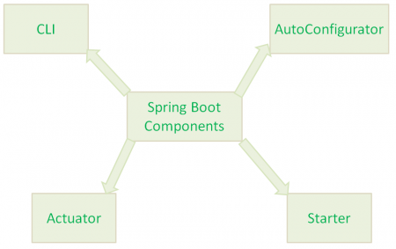
Key Components of Spring Boot Framework
Spring Boot Framework has mainly four major Components.
Spring Boot CLI
Spring Boot Starters
Spring Boot AutoConfigurator
Spring Boot Actuator

Slide 10
Spring Boot CLI
Spring Boot CLI(Command Line Interface) is a Spring Boot software to run and test Spring Boot applications from command prompt. When we run Spring Boot applications using CLI, then it internally uses Spring Boot Starter and Spring Boot AutoConfigurate components to resolve all dependencies and execute the application.

Slide 11
Spring Boot Starter
Spring Boot Starter is one of the major key features or components of Spring Boot Framework. The main responsibility of Spring Boot Starter is to combine a group of common or related dependencies into single dependencies.
For instance, we would like to develop a Spring WebApplication with Tomcat WebServer. Then we need to add the following minimal jar dependencies in your Maven’s pom.xml file or Gradle’s build.gradle file
Spring core Jar file(spring-core-xx.jar)
Spring Web Jar file(spring-web-xx.jar)
Spring Web MVC Jar file(spring-webmvc-xx.jar)
Servlet Jar file(servlet-xx.jar)

Slide 12
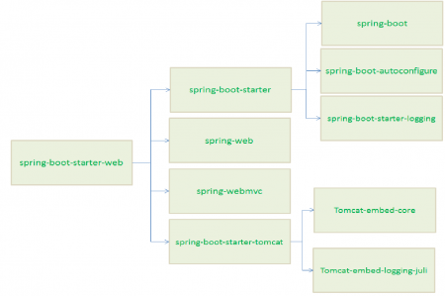

Slide 13
We need to define lot of dependencies in our build files. It is very tedious and cumbersome tasks for a Developer. And also it increases our build file size.
What is the solution to avoid this much dependencies definitions in our build files? The solution is Spring Boot Starter component.
Spring Boot Starter component combines all related jars into single jar file so that we can add only jar file dependency to our build files. Instead of adding above 4 jars files to our build file, we need to add one and only one jar file: “spring-boot-starter-web” jar file.

Slide 14
Spring Boot AutoConfigurator
To develop a Spring-based application requires lot of configuration (Either XML Configuration of Annotation Configuration). Then how to solve this problem.
The solution to this problem is Spring Boot AutoConfigurator. The main responsibility of Spring Boot AutoConfigurator is to reduce the Spring Configuration. If we develop Spring applications in Spring Boot,then We dont need to define single XML configuration and almost no or minimal Annotation configuration. Spring Boot AutoConfigurator component will take care of providing those information.

Slide 15
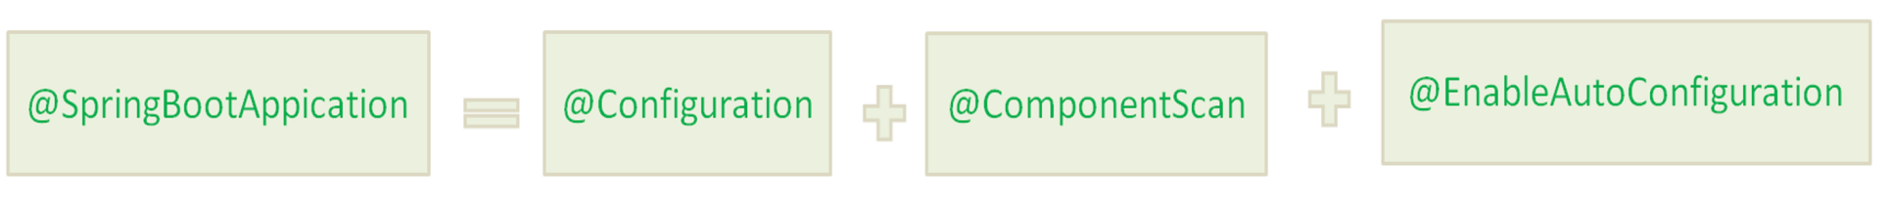
And also Spring Boot reduces defining of Annotation configuration. If we use @SpringBootApplication annotation at class level, then Spring Boot AutoConfigurator will automatically add all required annotations to Java Class ByteCode.
In simple words, Spring Boot AutoConfigurator reduces the Spring Configuration.

Slide 16
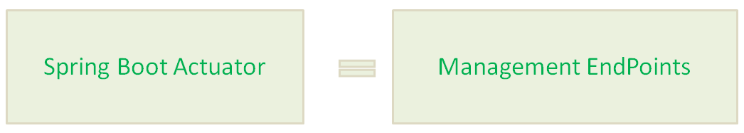
Spring Boot Actuator
Providing Management EndPoints to Spring Boot Applications.
When we run our Spring Boot Web Application using STS, Spring Boot Actuator automatically provides hostname as “localhost” and default port number as “8080”. We can access this application using “http://localhost:8080/” end point.

Slide 17
Limitation/Drawback of Spring Boot
Spring Boot Framework has one limitation.
It is very tough and time consuming process to convert existing or legacy Spring Framework projects into Spring Boot Applications. It is applicable only for brand new/Greenfield Spring Projects.
To Start Opinionated Approach to create Spring Boot Applications, The Spring Team (The Pivotal Team) has provided the following three approaches.
Using Spring STS IDE
Using Spring Boot CLI Tool
Using Spring Initializr Website

Slide 18
Example of Rest Web Service calling using Spring

Slide 19
Example of Rest Web Service calling using Spring Boot

Slide 20
Thank You

